Slide 1
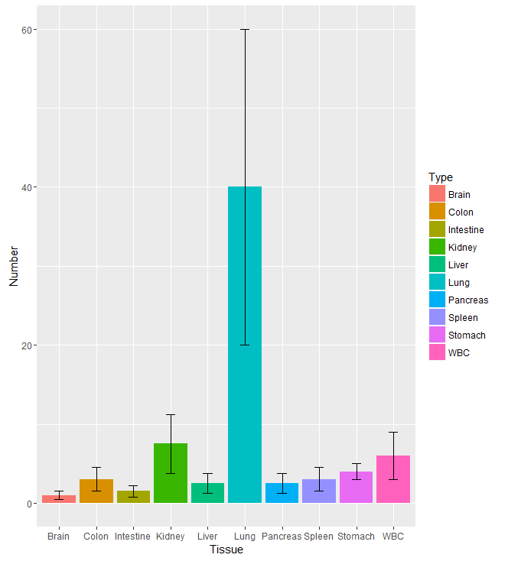
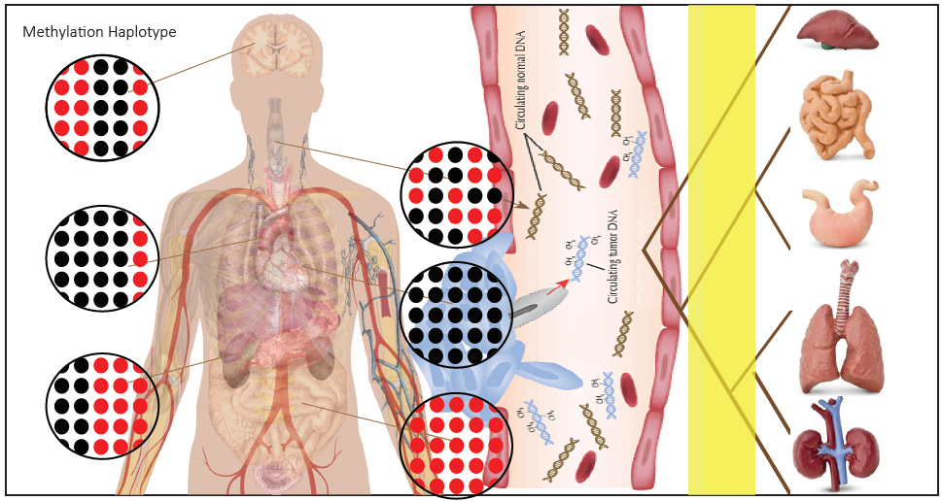
Deconvolution of epigenetic heterogeneity in human tissues and plasma DNA by tightly coupled CpG methylation.
Detect Tissue Specific Methyaltion Biomarkers
Disadvantage
1， Depend on MHL positive threshold;
2, Depend on our data (RRBS, biomarkers)
3, Only for tissue-of-origin, don’t know cancer or not

Slide 2
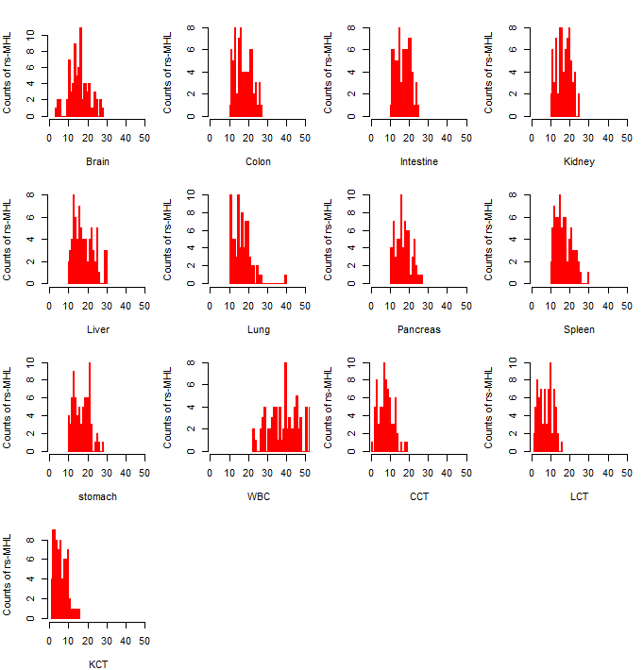
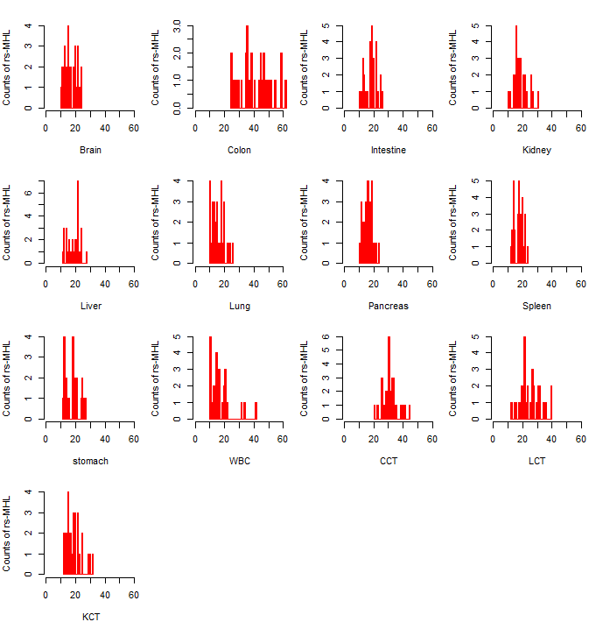
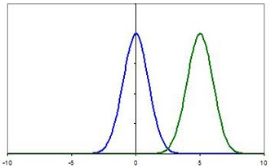
Distribution of reference specific MHL region in human normal plasma
75 Normal Plasma
30 Colon cancer
Tissue-of-origin
Pathology Status
Normal Plasma
CCR Plasma
Z-Score
200 regions for each reference were included.
MHL>0.135 defined as positive detection.
75 normal plasma samples
1, By Z-score rather than # ts-MHL
2, Control FDR (Type-I error)
3, Introduce CCT as reference
Significant higher WBC specific MHL
Notes:
The distribution of the tissue specific biomarkers are distributed in human normal plasma with approximate Gaussian distribution.
For colon cancer plasma, we can expect that the join distribution of colon and colon cancer specific MHL should be have higher values compared with other recombination.

Slide 3
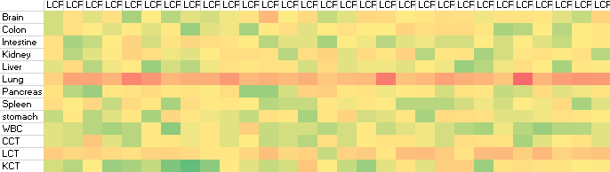
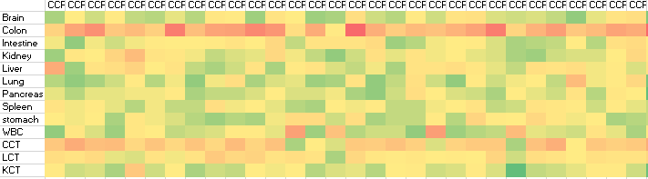
Tissue and tumor of origin mapping based on specific hyper-MHLs in MONOD
Five-fold cross-validation to fix threshold Z-score with different FDR
A B C D E
Z-score|(plasma sample, reference)
1. A(Tissue-of-origin)| max(Z-score) among reference
2. P-value(Z-score) for each reference
3, multi-hitting to one tissue
P-value (joint P-value) Matrix
ROC Curve
Multiple Disease Prediction
Diabetes, Cancer, rheumatoid arthritis

Slide 4
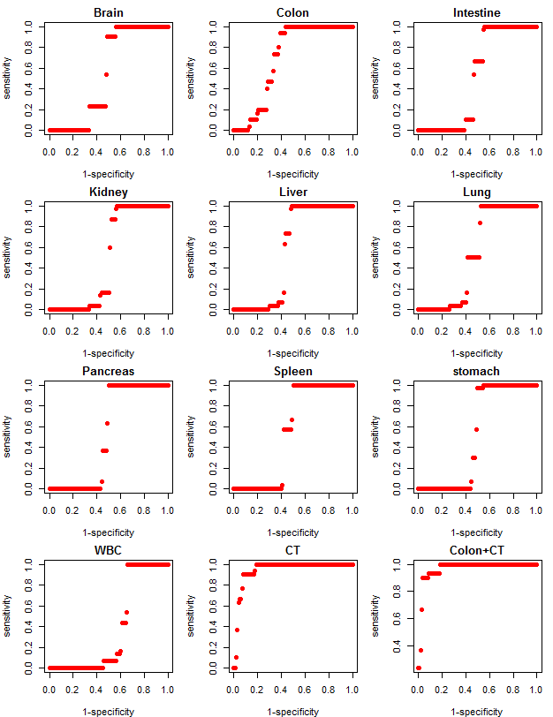
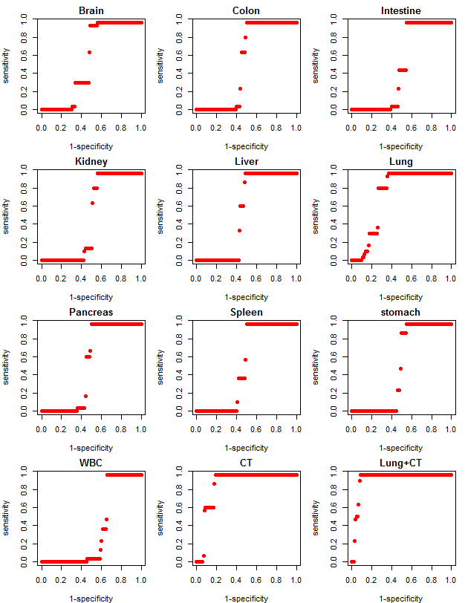
Tissue and tumor of origin mapping: ROC curve
Colon cancer plasma
Lung cancer plasma
Conclusion:
1, Only Tissue-of-origin and pathology status have significant prediction ability.
2, It seems the specificity to distinguish different cancer is not as powerful as tissue
which is related to reference build since cancer heterogeneity is higher compared with normal tissue

Slide 5
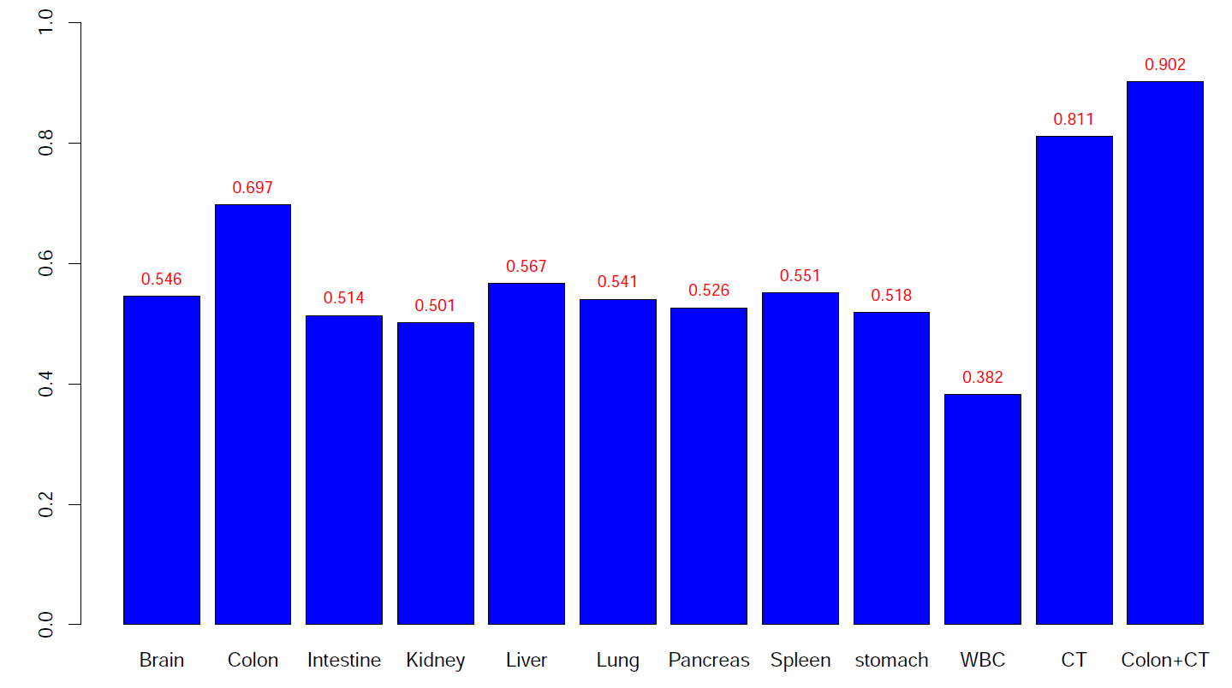
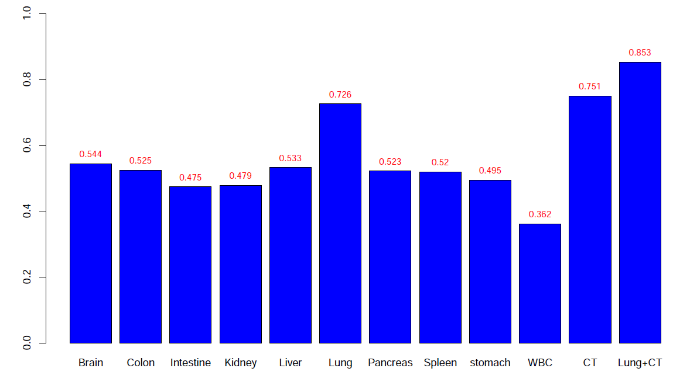
Tissue and tumor of origin mapping: AUC value for each reference
Tissue and cancer signal will have
higher AUC while others is about ~0.5

Slide 6
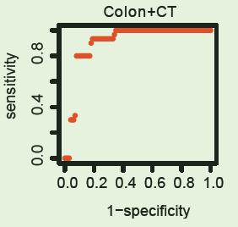
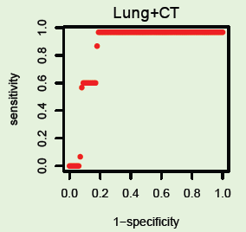
Tissue and tumor of origin mapping: multi-hitting
Conclusion:
Combine tissue-of-origin and pathology status will show quite good performance
Sensitivity > 0.9 given specificity ~ 1

Slide 7
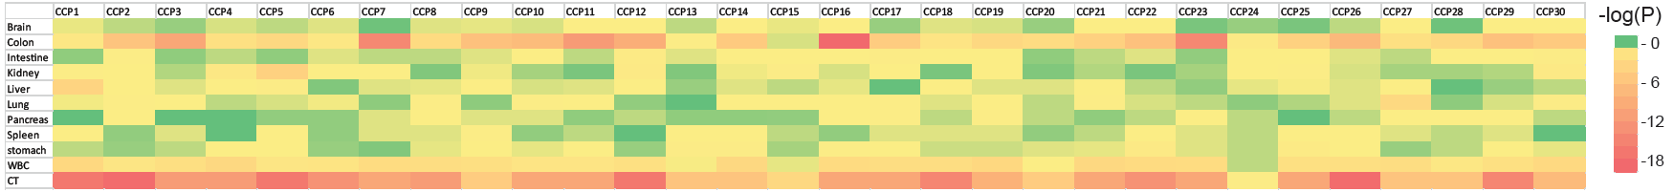
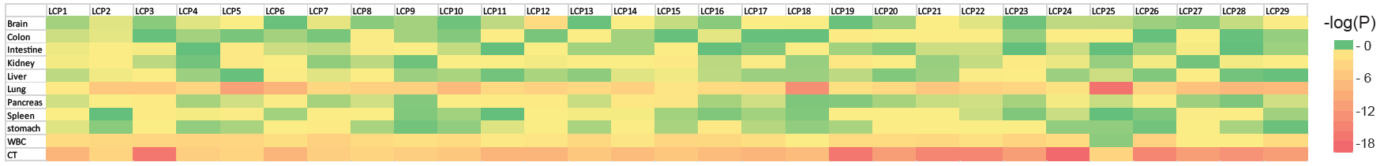
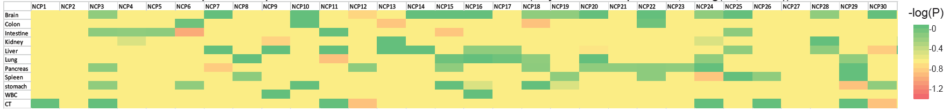
Tissue and tumor of origin mapping: P-value matrix
Colon cancer plasma (-log P)
Lung cancer plasma (-log P)
Normal plasma (-log P)
Conclusion:
1, Z-score based test could provide uniform P-value for each sample in each reference.
2, This method could extended to provide more information, not only tissue-of-origin, cancer.
3, Be careful to compare with normal plasma to filter out false positive result.

Slide 8
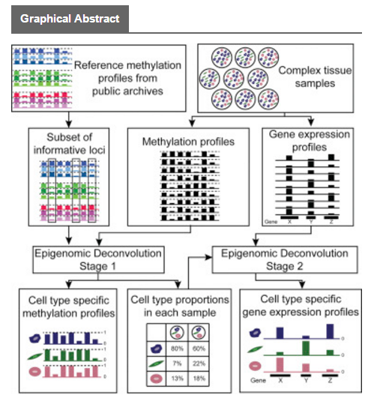
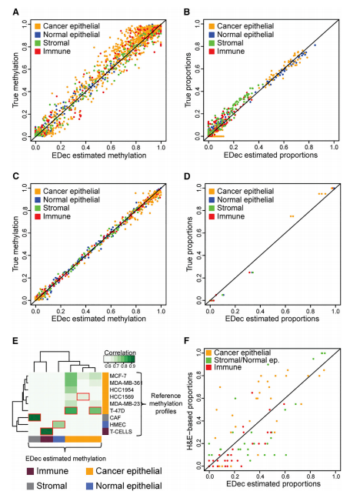
Epigenomic Deconvolution of Breast Tumors Reveals Metabolic Coupling
between Constituent Cell Types
Methylation Deconvolution
1000 regions (300bp, 89 OL, P<10⁻²²)
Target BS-seq (depth>200)
RNA-seq Deconvolution
Vitor Onuchic et al, Cell Reports,(17:8), 15 Nov 2016

Slide 9
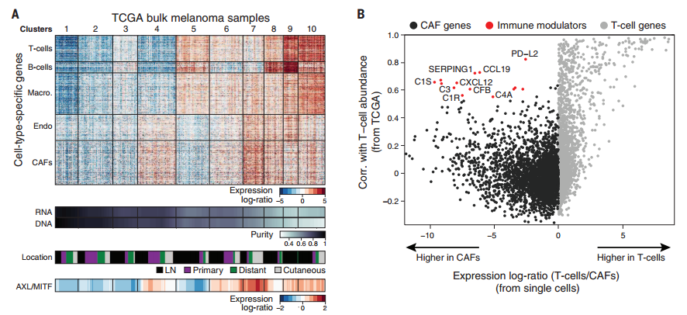
Dissecting the multicellular ecosystem of metastatic melanoma by single-cell RNA-seq
Fig. 4. Deconvolution of bulk melanoma profiles reveals cell-to-cell interactions. (A)
Itay Tirosh et al, Science,(352:6282), 08 Apr 2016
Differential test
Interaction Analysis (Gene and Gene, Cell and Cell)
Combination of Reference and non-reference deconvolution
eQTL network
…….
Deconvolution =>

Slide 10
Thanks

